Slide 1

Welcome
Titus County
2026 Primary Election
Poll Worker Training

Slide 2
Overview
Pick up Supplies the day before Election Day
Polling Location Set up at 6:00 a.m. on Election Day
Polling Place Do’s and Don’t
Dress Code
Qualifying Voter with ID
Pollpads/ Combination forms
Closing the Polls on Election Night
Data Runner
Paperwork Completion
Supplies Return

Slide 3
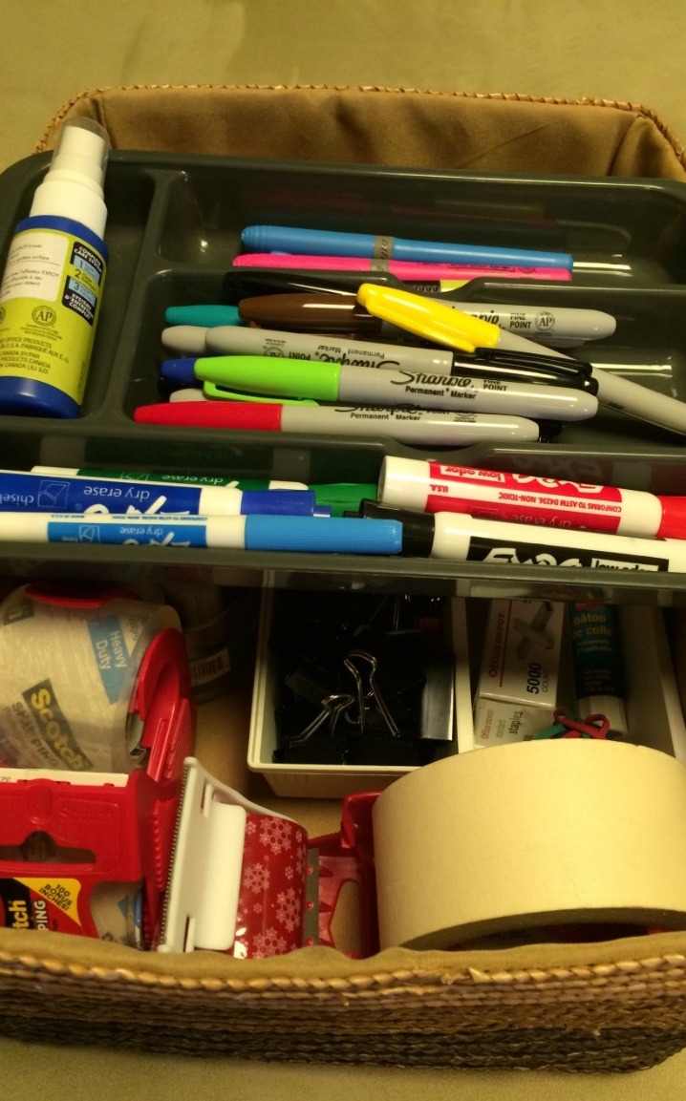
PICK UP SUPPLIES
Judges, please come by the Elections Office on the day before the Election to be sworn in, pick up your bag of supplies, ballots, and PollPad or combination forms and voter list
March 2, 2026 after 10:00 a.m.

Slide 4
Polling Location Setup 6:00-7:00 a.m.
The 7 Set-Up Tasks:
Post the distance markers.
Arrange the room and ballot boxes.
Post sample ballots and informational signs such as the Acceptable ID Poster, Voter Information Poster, Voter Complaint Information Poster, No use of electronic devices (cell phones) in the polling place (Notice of Certain Devices Within 100 Feet of Voting Station), Notice of Electioneering, etc.
Set up the Voter Screen and make sure The Voting Instruction signs are in each one.
Put pens in each voter screen
Set up the Voter Qualifying Table(s). Post Party Signs at each table.
Ready the electronic voting equipment.
If you need help, there are training videos on
www.co.titus.tx.us under County Elections

Slide 5
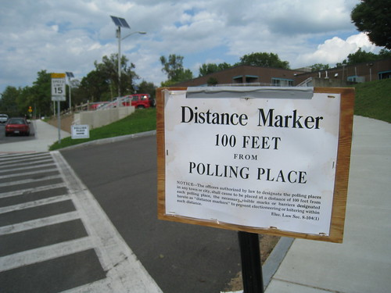
Set Up Tasks
POST THE DISTANCE MARKERS
Place the Distance Markers 100 feet from each building entrance through which voters may enter. Loitering and electioneering inside the 100-foot Distance Markers are not allowed.
Prohibited items with 100 feet of a voting station:
Texas Election Code § 61.014 Cell phones, tablets, cameras, laptops, smart watches, sound recorders or any other wireless communication or recording device
NO Electioneering, which means: NO Campaign, Candidate, or Party Literature
NO Wearing/Displaying Campaign, Candidate, or Party Buttons, Hats, Shirts, Signs, Flags, etc.
Section 46.03(a) of the Texas Penal Code generally prohibits a person from bringing a firearm onto the premises of a polling place. This prohibition does not apply to a peace officer, regardless of whether the police officer is on or off duty. For this and other potentially applicable exceptions, see Tex. Pen. Code § 46.15. The legislation allowing open carry of handguns does NOT change the law as it pertains to guns in the polling place; thus no one except licensed peace officers may carry handguns into the polling place.

Slide 6
Arrange the Room and Ballot Box
Work together to position the qualifying table(s) and label them
Arrange privacy screens assuring that voting will be private
Position poll watchers’ chairs so that they can view and hear interactions at the qualifying table
Place the Ballot Box where it is visible to an Election Clerk at all times
Note: The voting equipment must be visible to the Presiding Judge and/or Election Clerk at all times while the polls are open to guard against unauthorized access.

Slide 7
Post Informational Signs
In each voting booth you must post the Voting Instructions, including Write-in list
Post the Sample Ballot, Acceptable ID Poster, Voter Complaint Poster, Notice of Voting Order Priority
Also to be posted- Notice of Total Numbers who have Voted (Election Day) and Notice of Certain Devices.
Note: Be sure to place these close to where voters are waiting in line. The NO Electioneering sign needs to be on the building entrance.

Slide 8
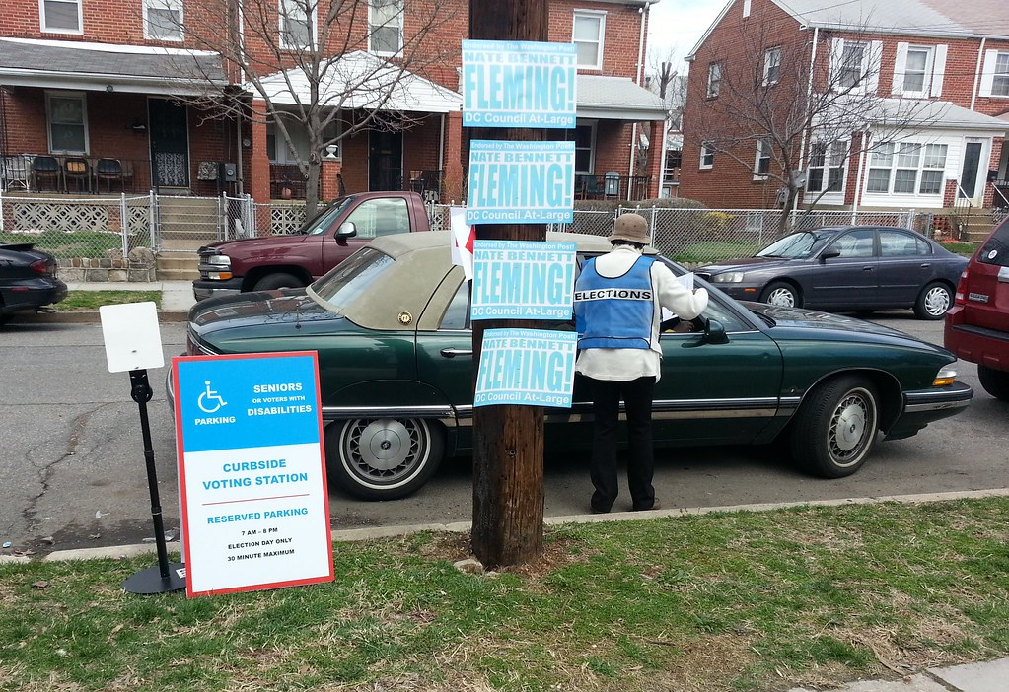
Curbside Voting Tools “Curbside voting is a method of in-person voting where voters who are unable to physically enter their polling place (e.g., due to a disability) may request that a ballot be brought outside of the polling place to an accessible location such as a vehicle. ”
Curbside Clipboard
Statement of residence
Assistance Form
More than 7 in a vehicle form
Curbside Ballot Box or Envelope
I Voted Stickers

Slide 9
Polling Place Do’s & Don’t
Do
Be polite and courteous
Verify each voter using their approved photo ID
Assist when asked
Modulate your voices so the voters can read their ballot
Maintain accurate records and fill out all paperwork completely
Don’t
Engage in idle discussions with the voters
Talk about politics AT ALL
Argue with voters or your fellow workers
Over-react or feed a voter’s fears
Pretend you know what to do in a difficult situation, ask if you need help

Slide 10
Dress Code
Keep in mind that you represent Titus County
What does your clothing say to a voter?
You will be working long hours
Name tags- Texas Election Code §61.010(b)

Slide 11
Voter Qualifying Table
Arrange required forms and materials from the Election Kit on each qualifying table along with the Poll Pad and its printer.
Note: Attach labels to all forms in the forms folder, and fill in the information on them. Do not wait until the end of the night to do this. Do this during slow times of the day.

Slide 12
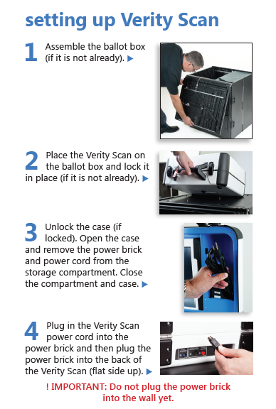
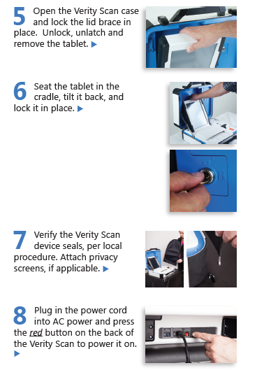
Set Up Task #5- Ready the Electronic Voting Equipment Training Videos are on http://co.titus.tx.us/county_elections/videos/Scanner%20Training.mp4

Slide 13
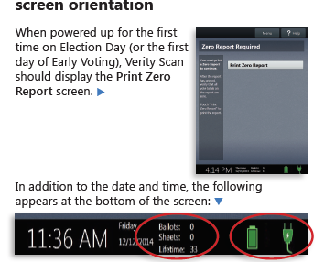
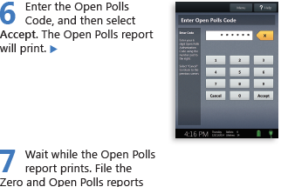
Verity Scan (cont.)
Print Zero Report

Slide 14
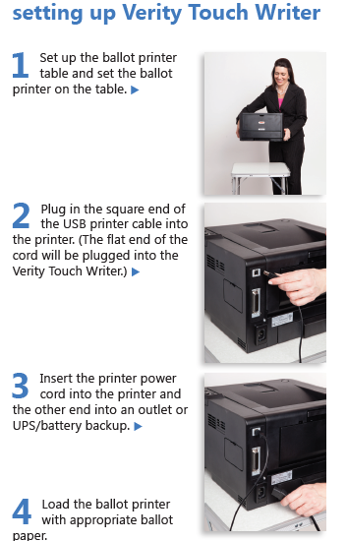
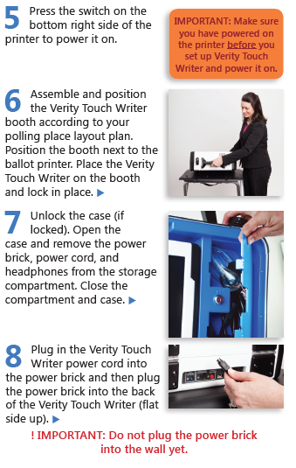
Verity TouchWriter- Traing Video is at http://co.titus.tx.us/county_elections/videos/Touch%20Writer%20Training.mp4

Slide 15
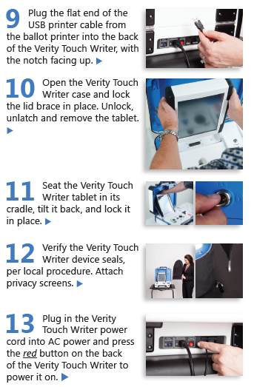
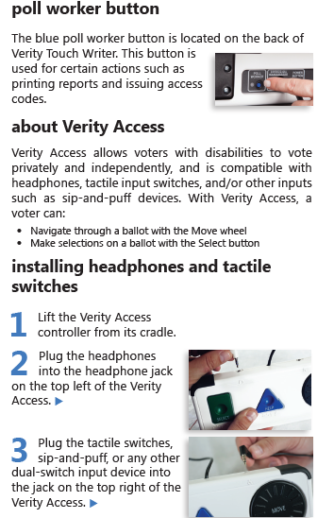
Verity TouchWriter (cont.)

Slide 16
Verity TouchWriter (cont.)
Before installing the screen into the cradle, connect the battery supply pack accessible on the back panel.
Power on the machine.
Print Zero Report
Open Polls using code
File Open Polls Report and Zero Report with red bag materials.

Slide 17
Meet your PollPad
Training Video is at:
http://co.titus.tx.us/county_elections/videos/Poll%20Pad%20Training.mp4

Slide 18
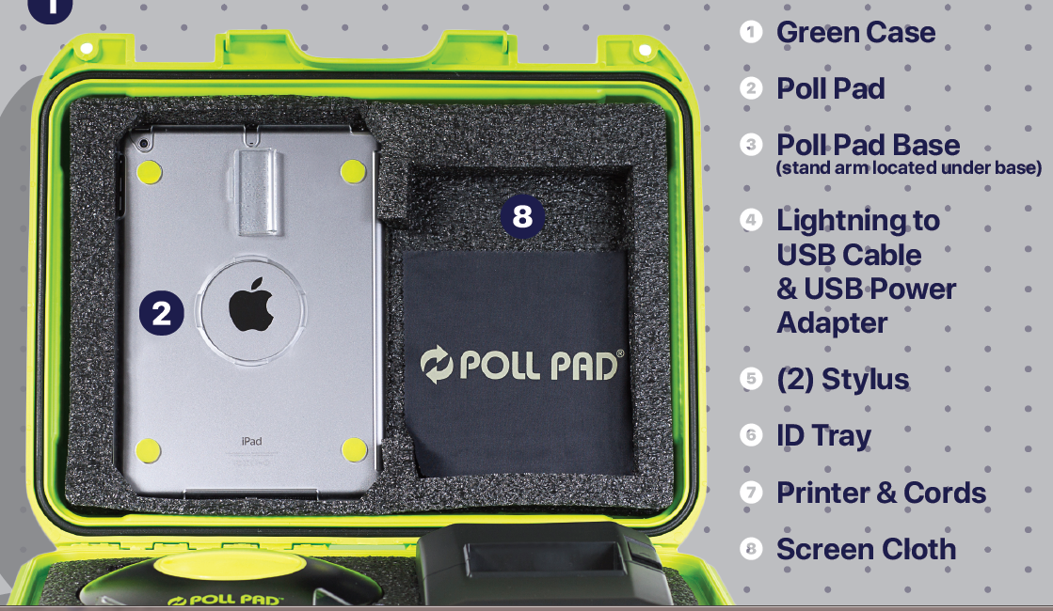
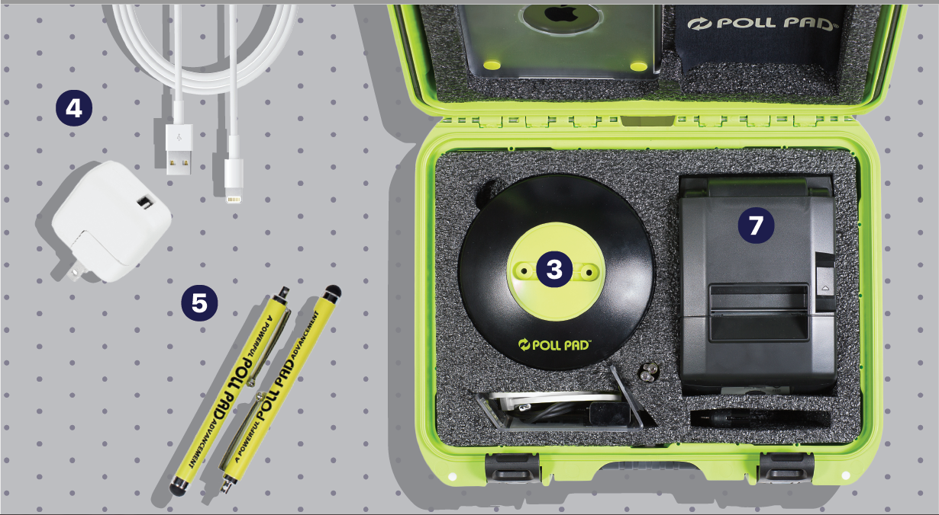

Slide 19
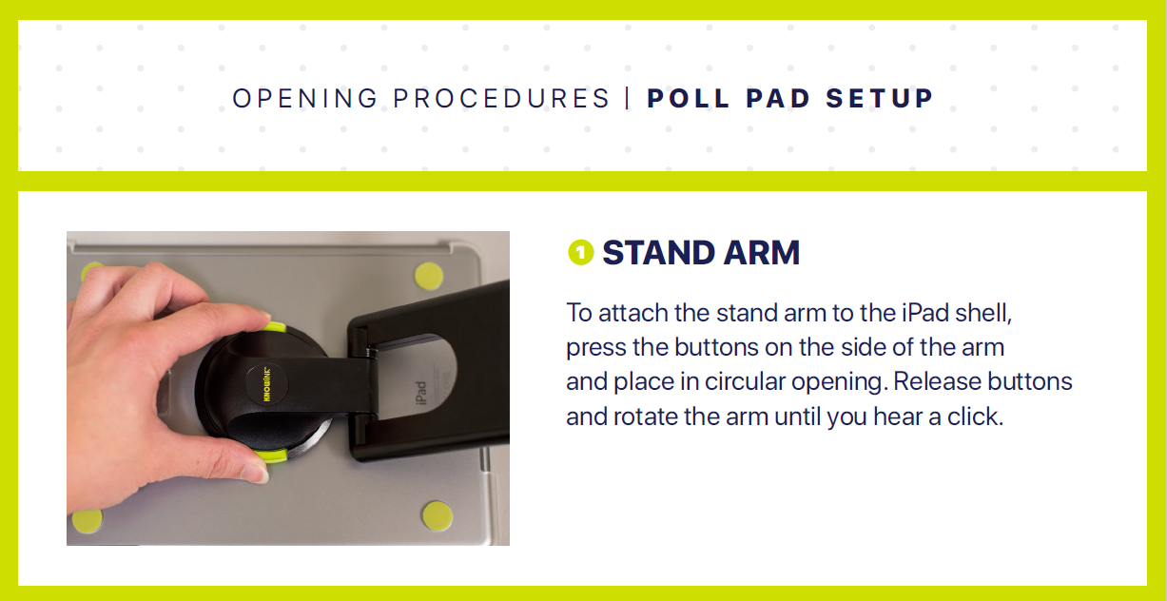
Set Up

Slide 20
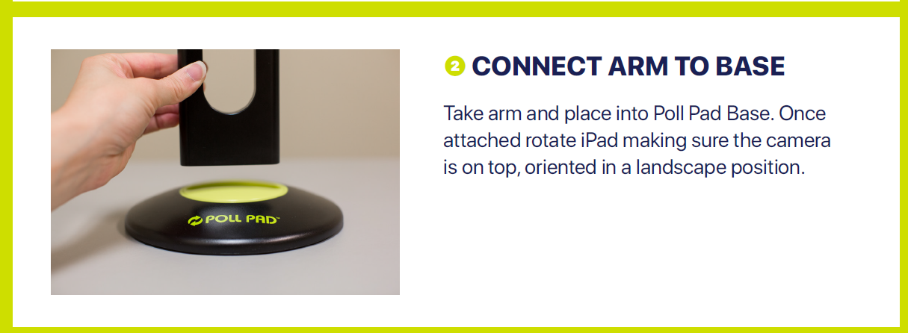
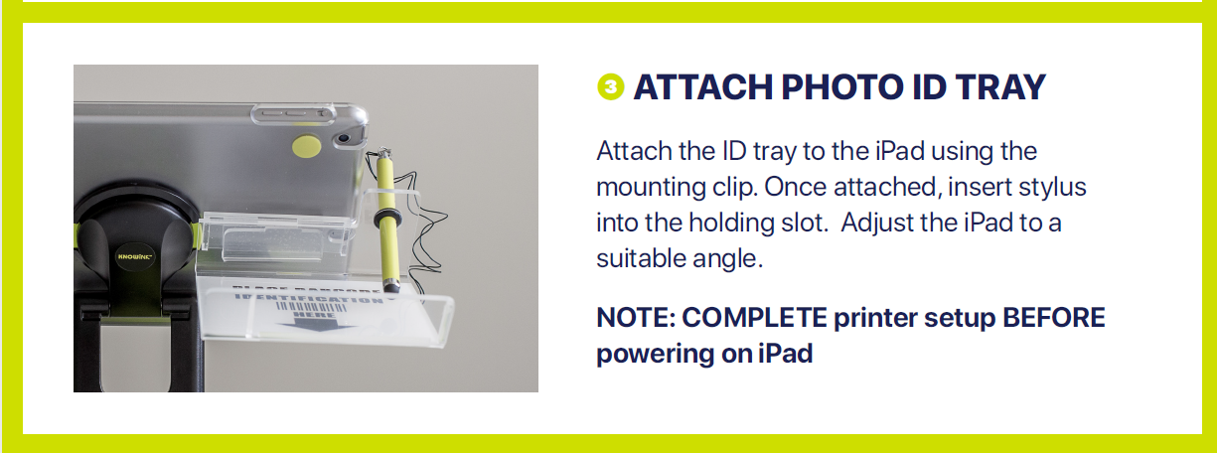

Slide 21
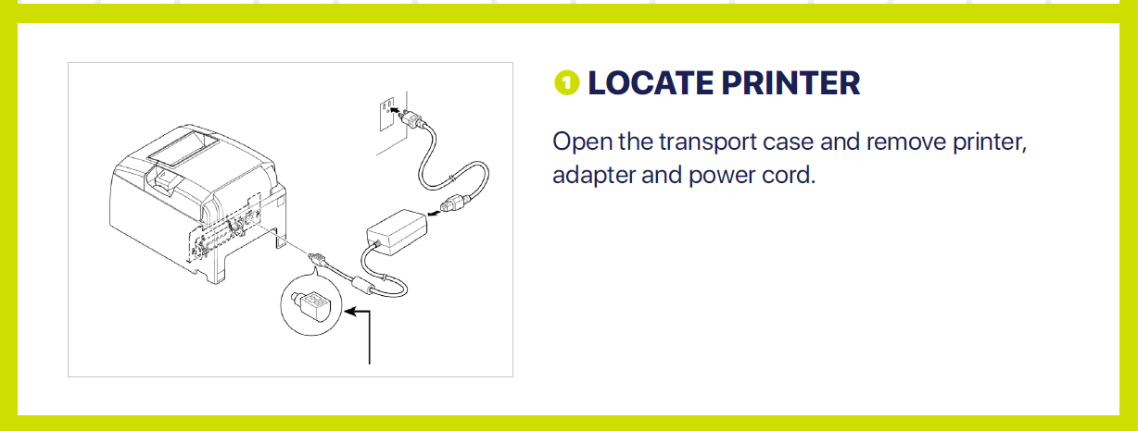
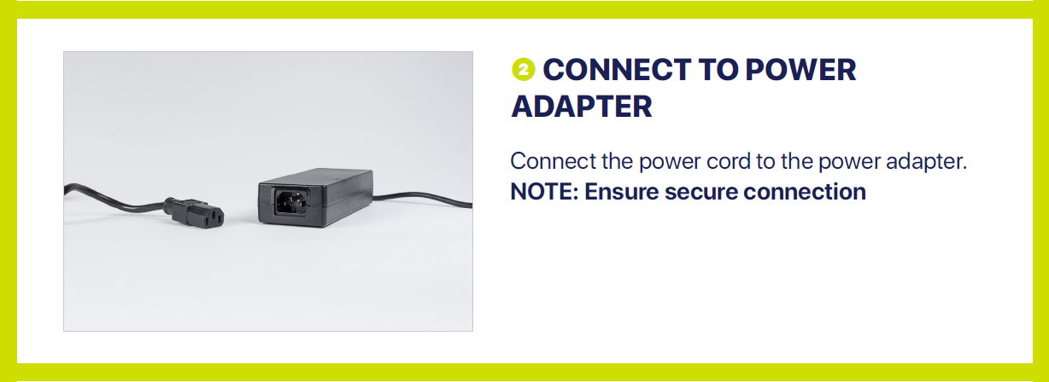

Slide 22
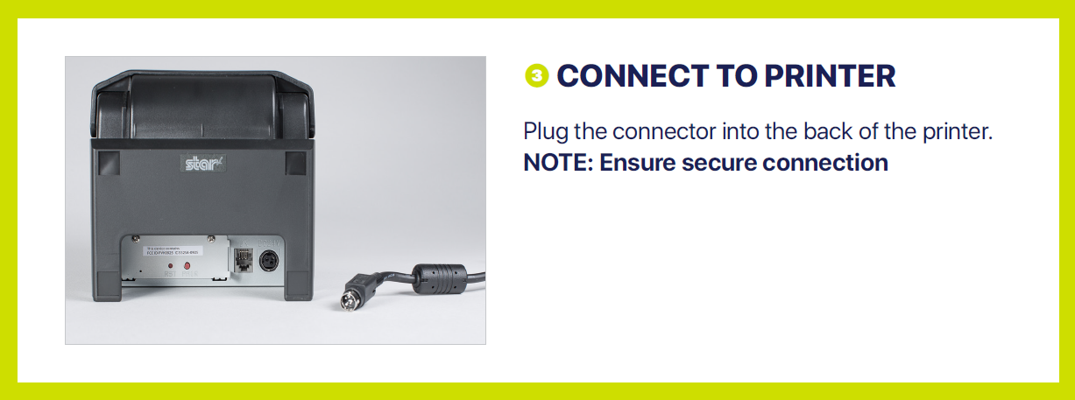
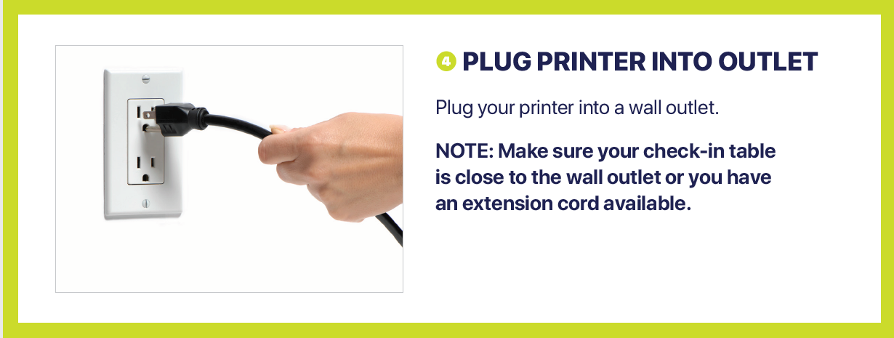

Slide 23
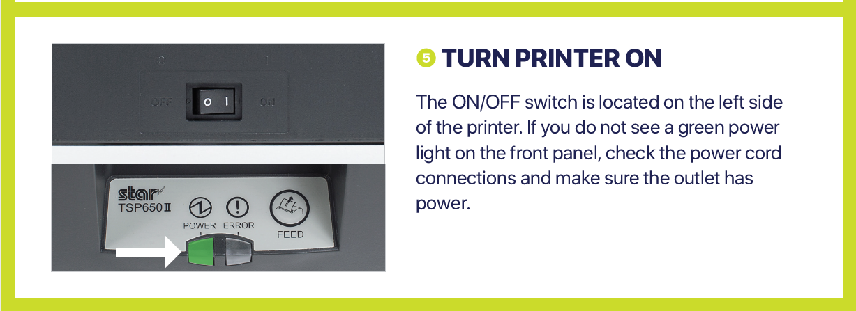


Slide 24
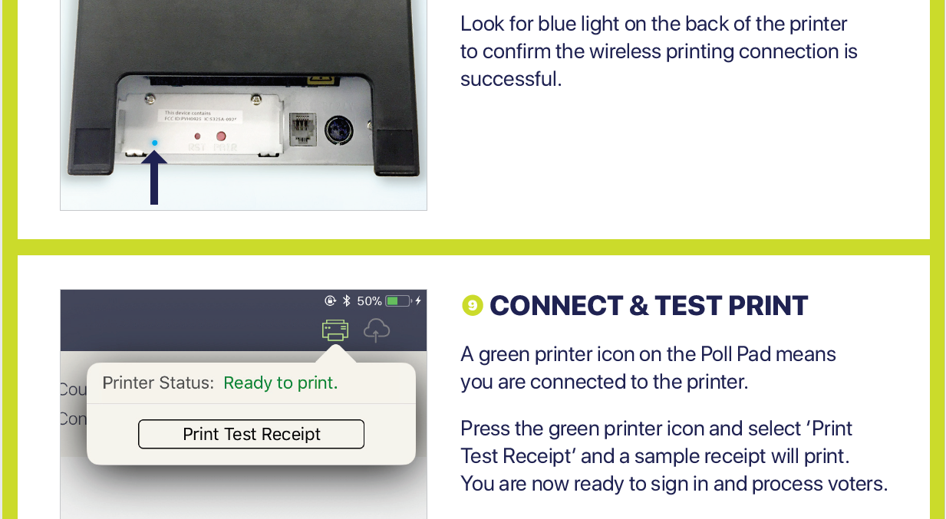

Slide 25
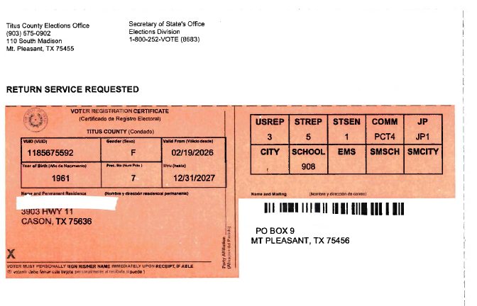
Qualifying the Voter
The Voting Precinct is the location the voter should be voting at.
The voter is NOT required to present a voter registration card to vote. This card is to inform the voter of their Voter Unique Identification Number (VUID #), their Voting Precinct, and districts they fall under according to their residence address. If you can not find a voter in the Pollpad, call our office and we can research further.

Slide 26
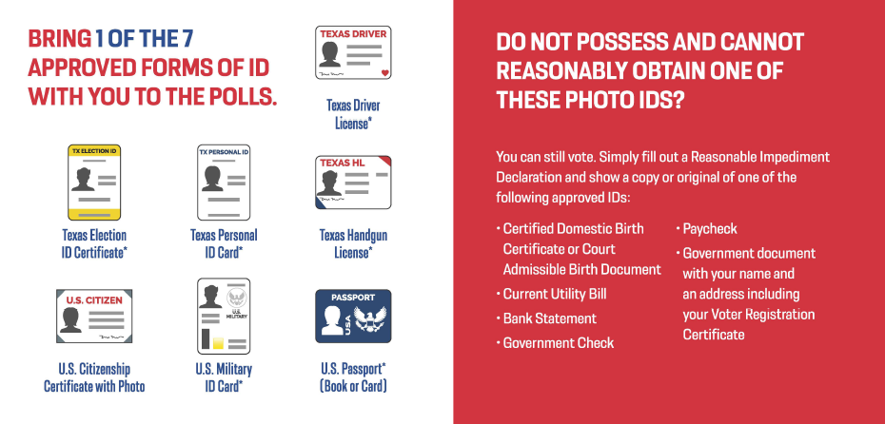
Note: If they only have a picture of an ID and not an original, have them complete the Reasonable Impediment form. They have 6 days from Election Day to bring a physical copy of their ID to the Titus County Election Office.

Slide 27
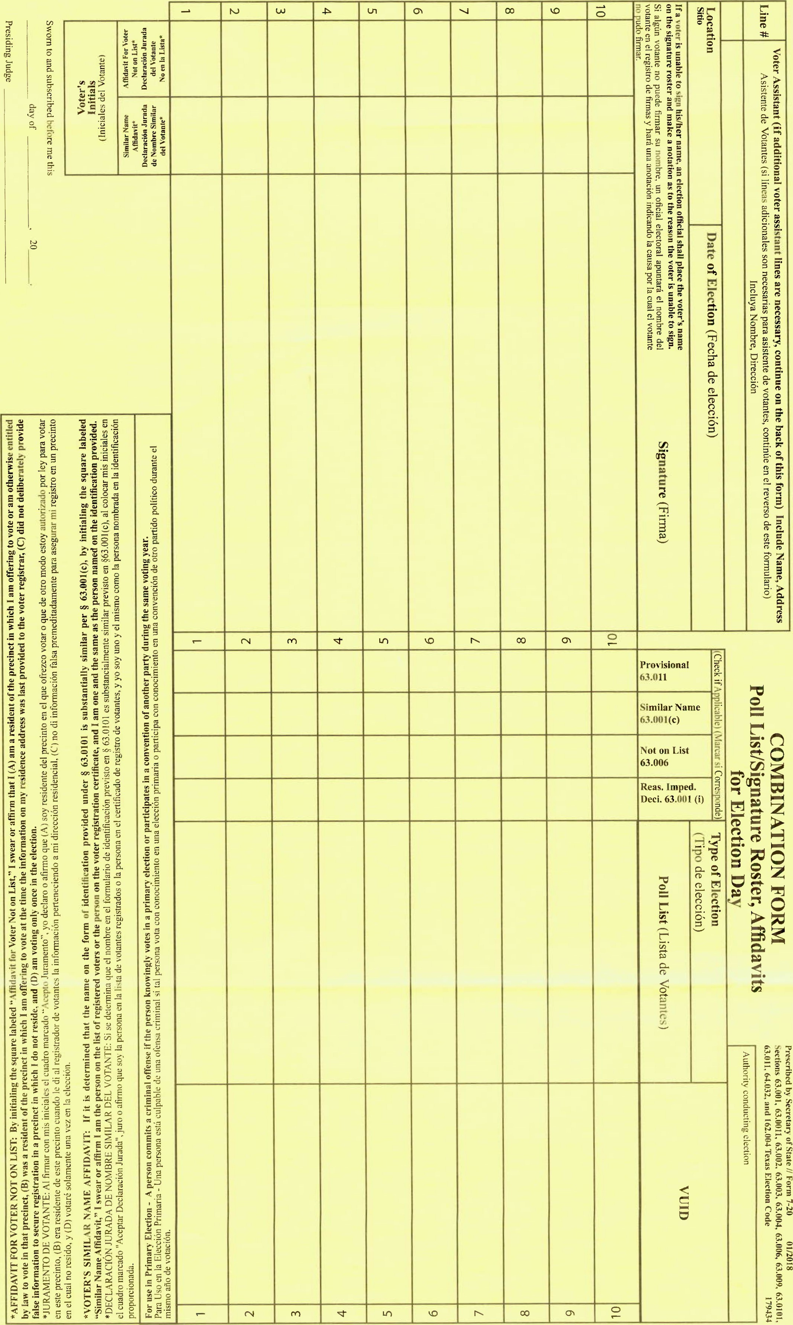
Combination forms

Slide 28
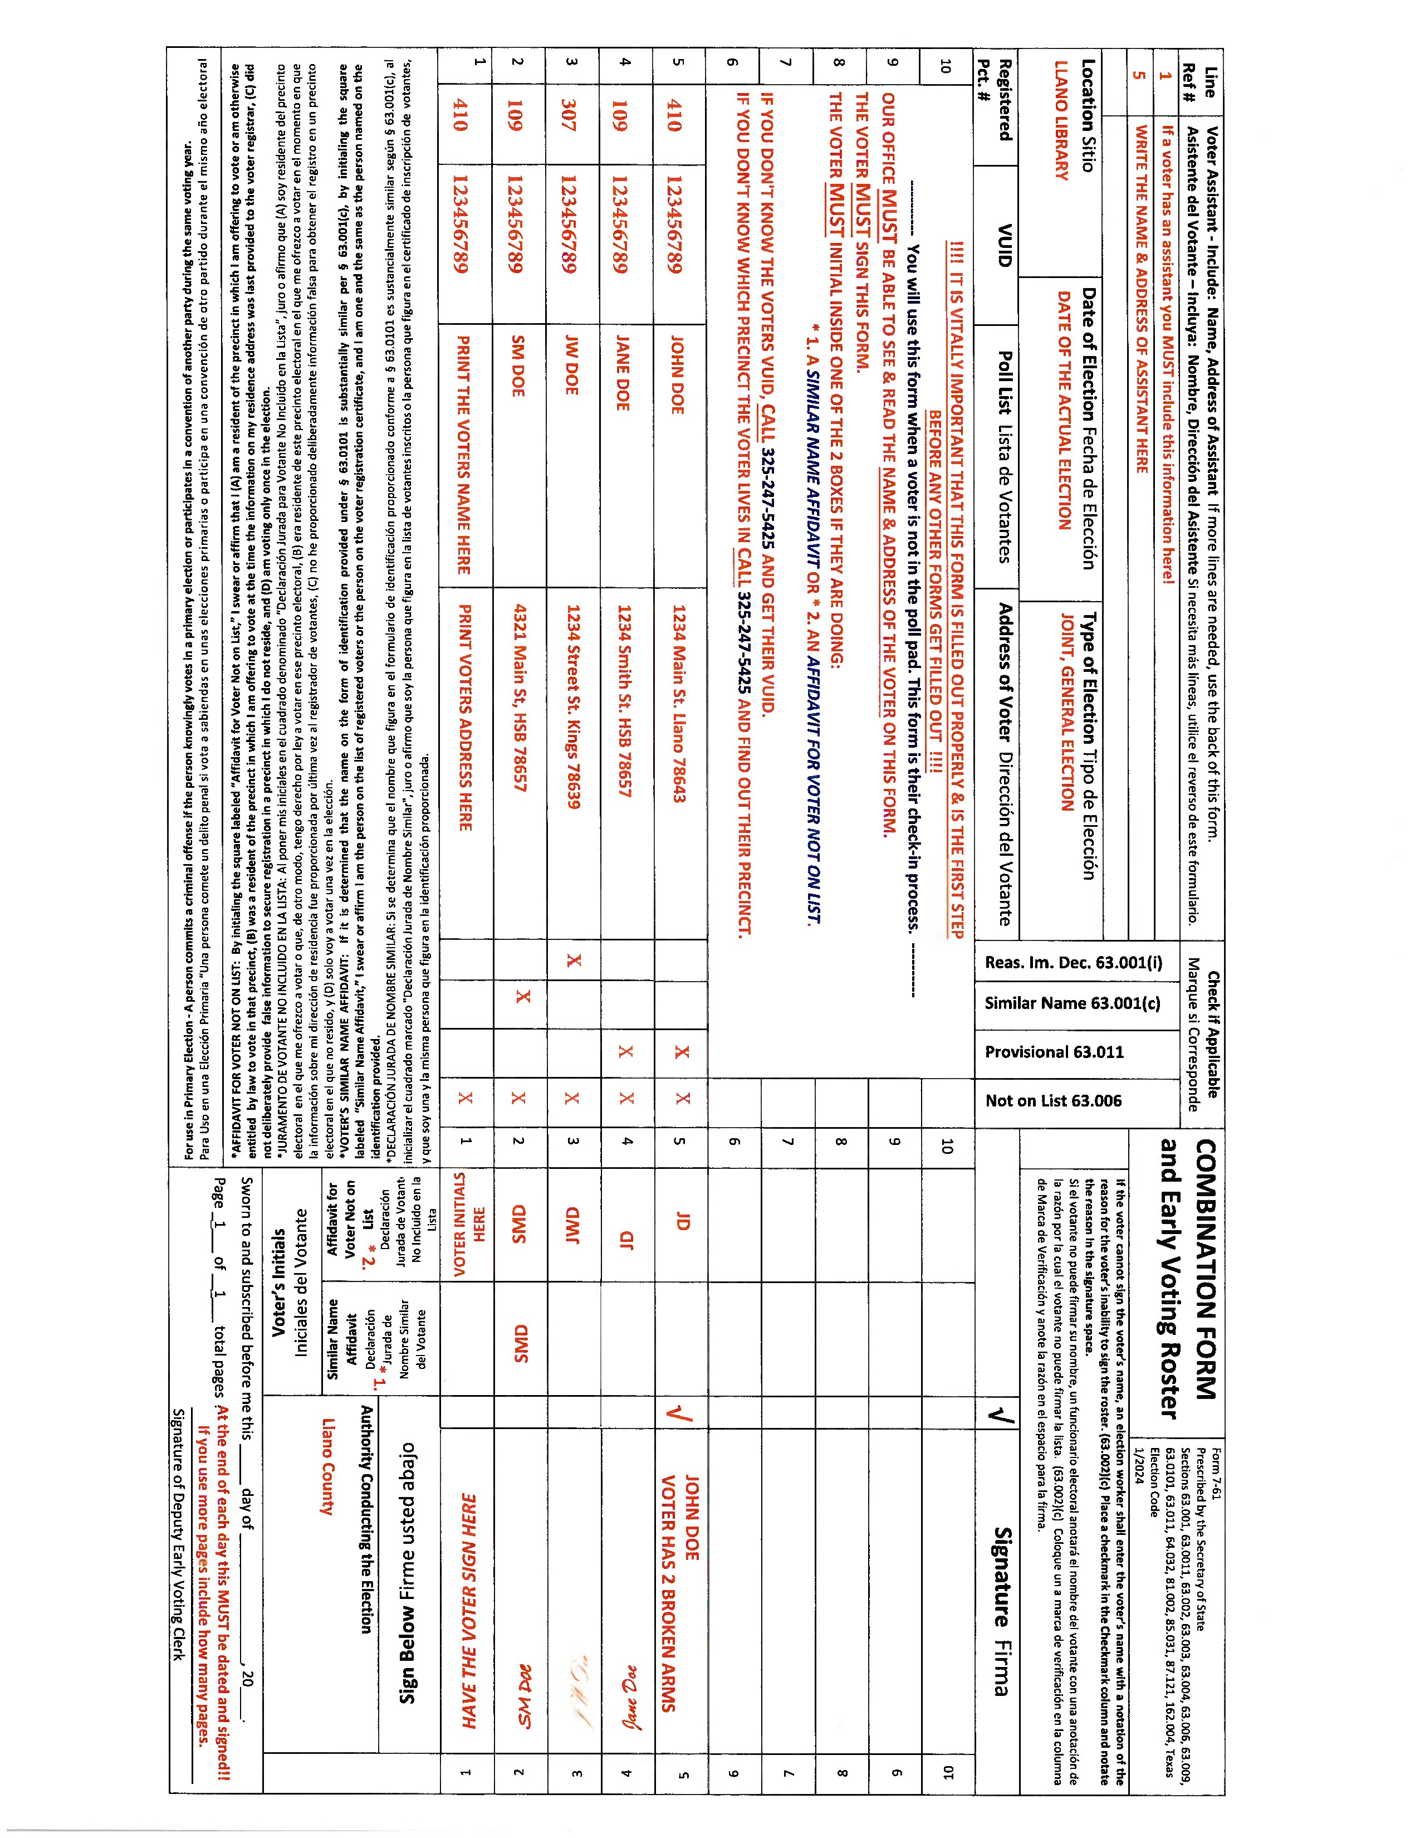
Example:
903-575-0902
903-575-0902

Slide 29
Completing a Combination Form
Fill out voter name and 10-digit vuid number
Remember to check the boxes, if applicable.
Have voter sign on the line next to their name and initial affidavit if applicable
Send voter to the table/clerk for a ballot

Slide 30
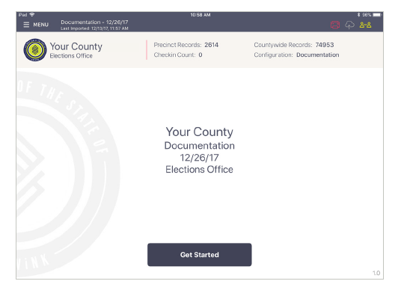
Processing Voters on Pollpad

Slide 31
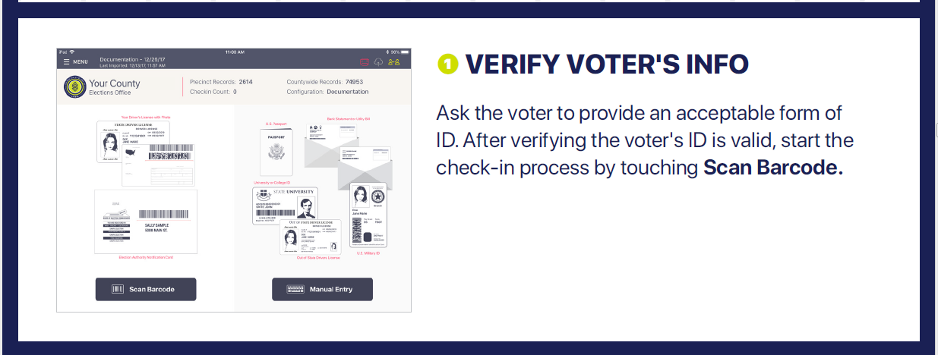
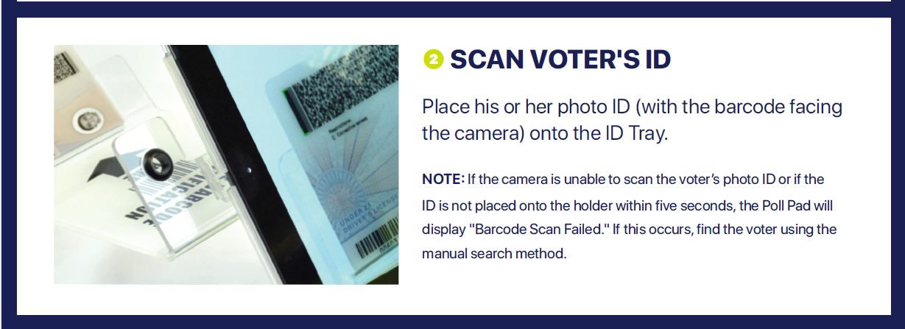

Slide 32
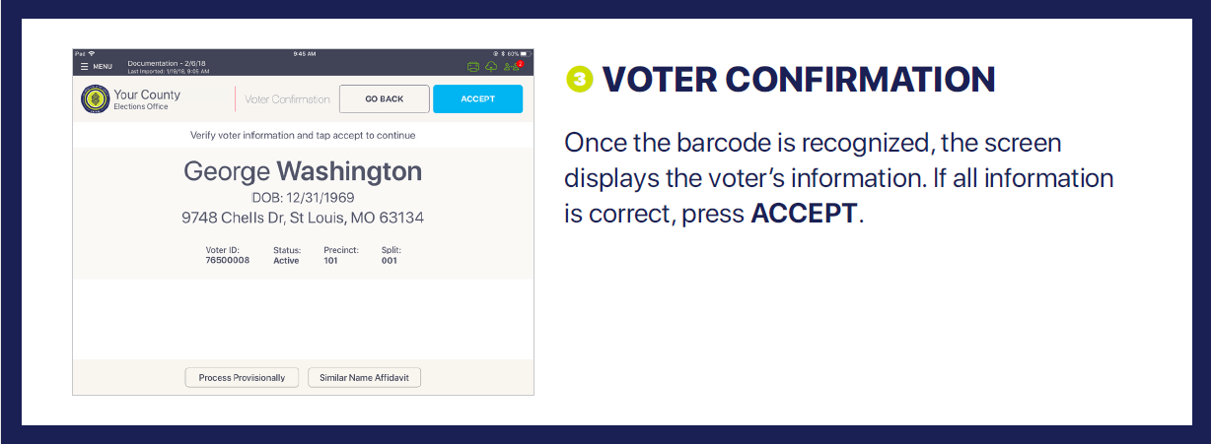
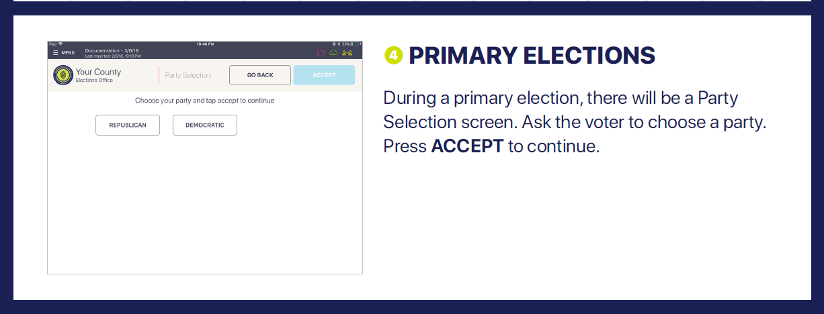

Slide 33
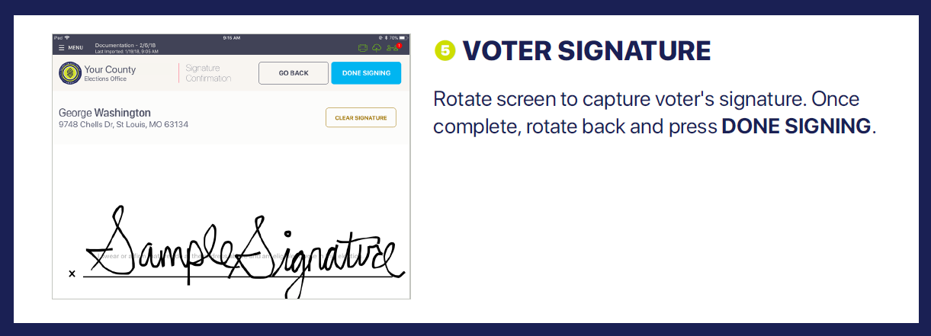
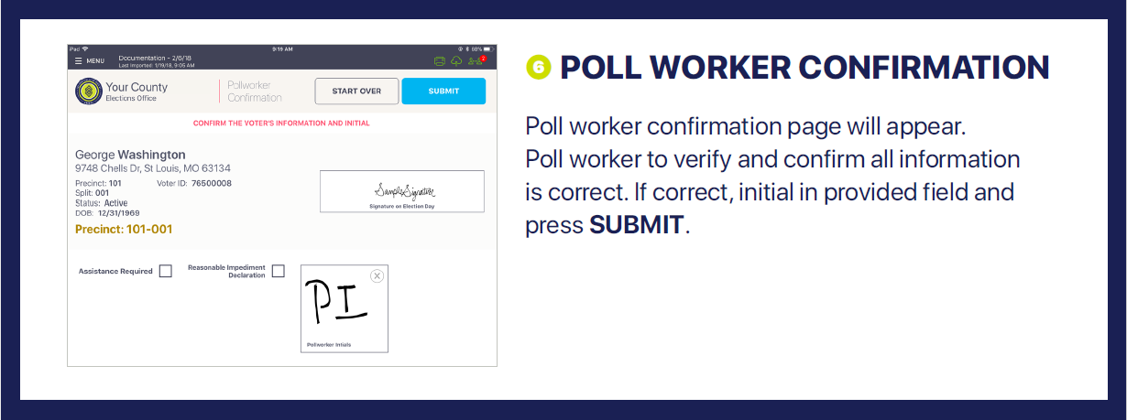

Slide 34
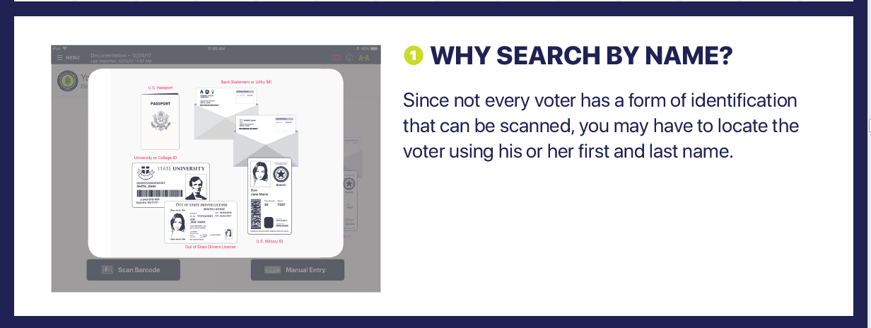
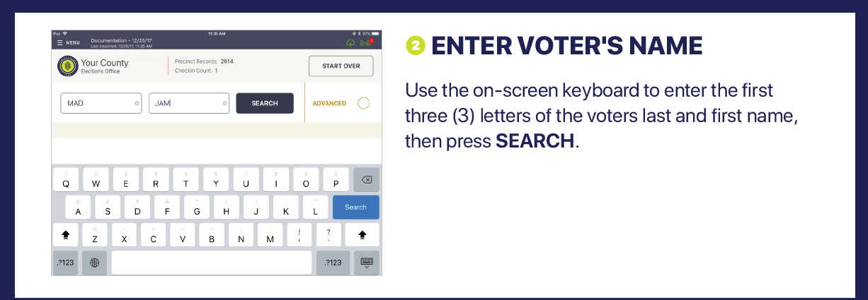

Slide 35
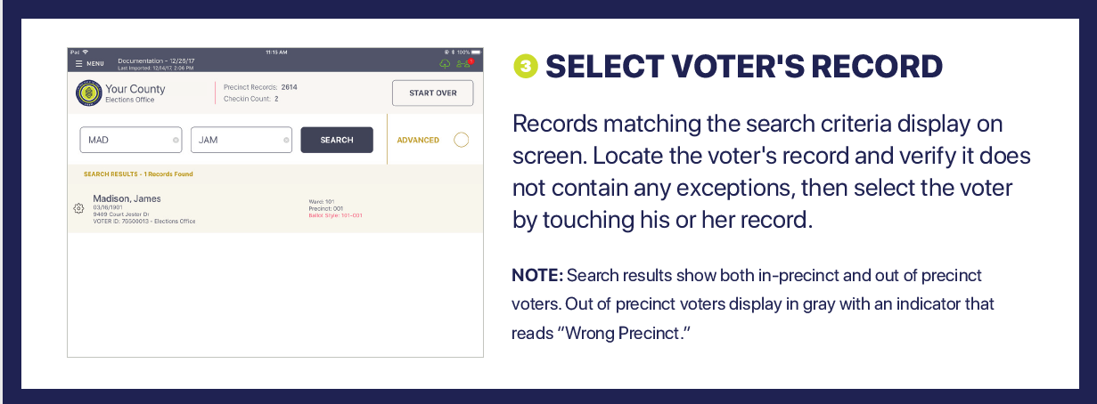
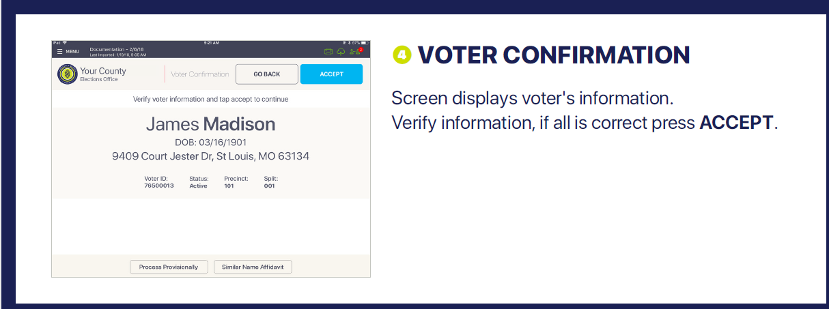

Slide 36
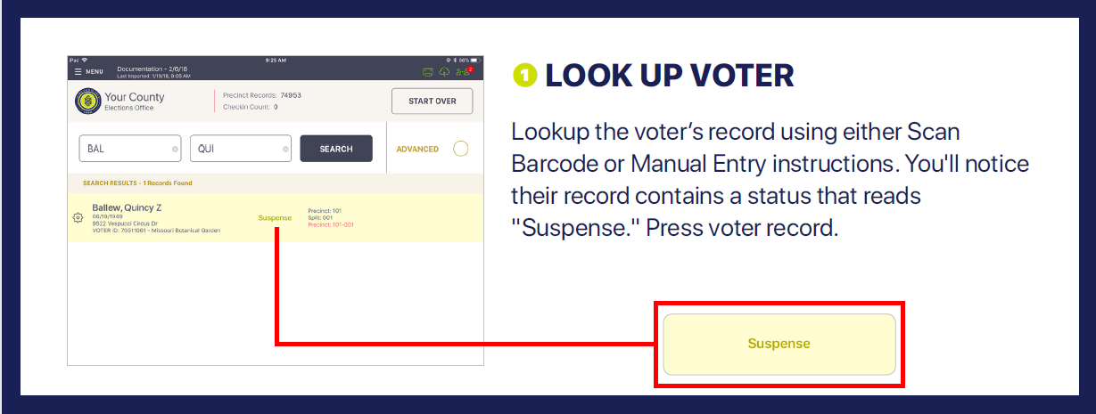
If voter is in SUSPENSE status- You MUST have them fill out a Statement of Residence.

Slide 37
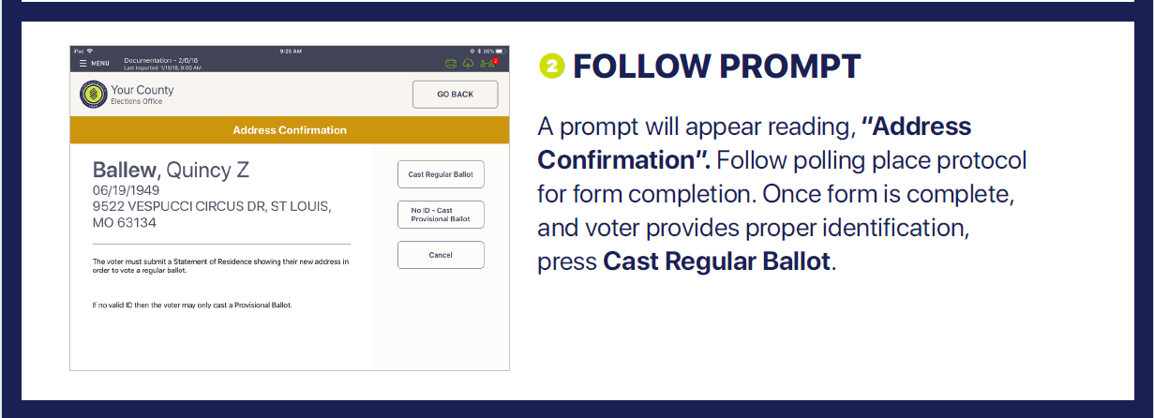
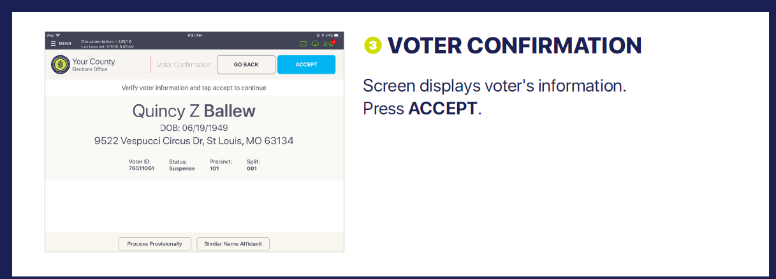

Slide 38
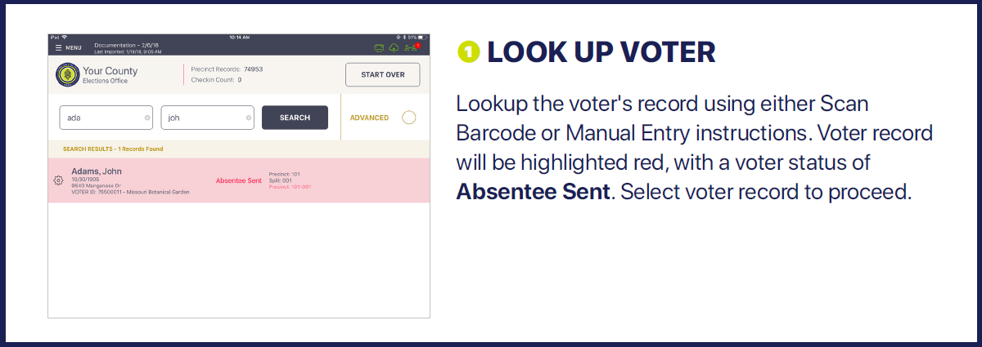
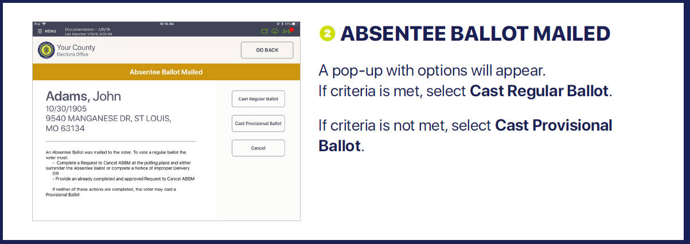
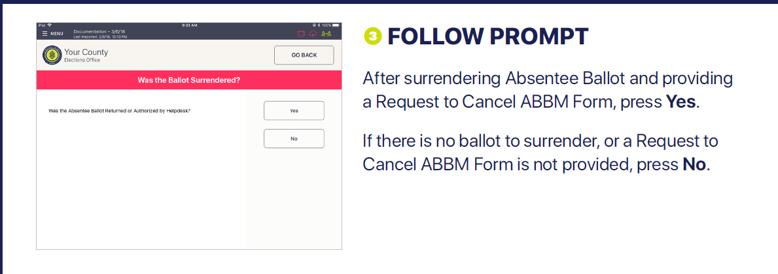

Slide 39
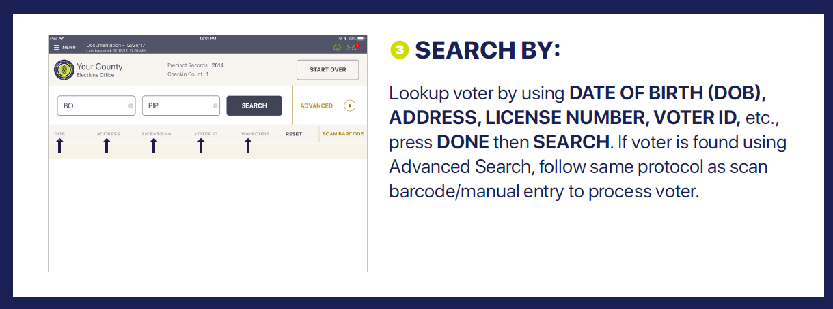
Different ways to search for voter

Slide 40
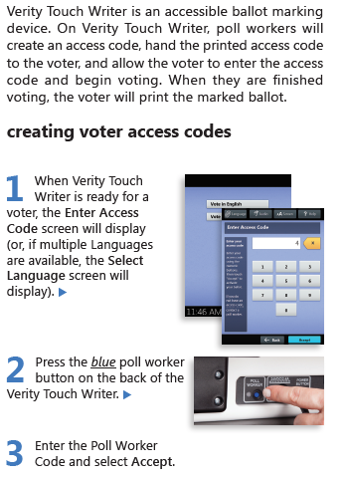
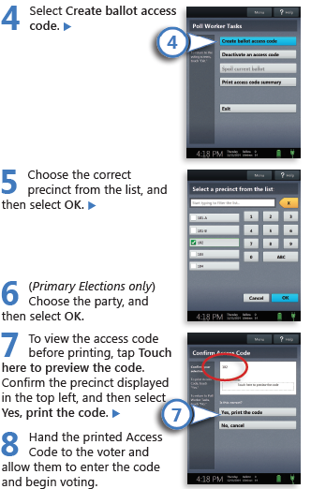
Voting with Verity TouchWriter

Slide 41
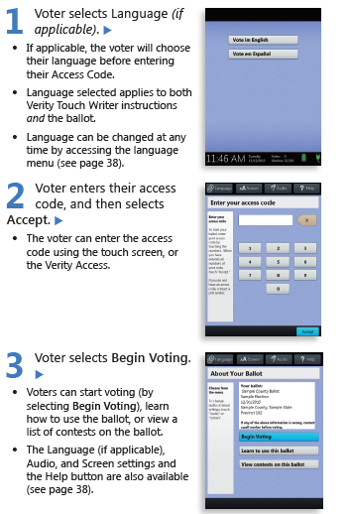
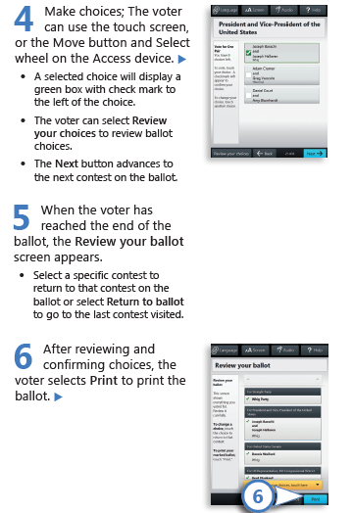
Voting with Verity Touchwriter (cont.)

Slide 42
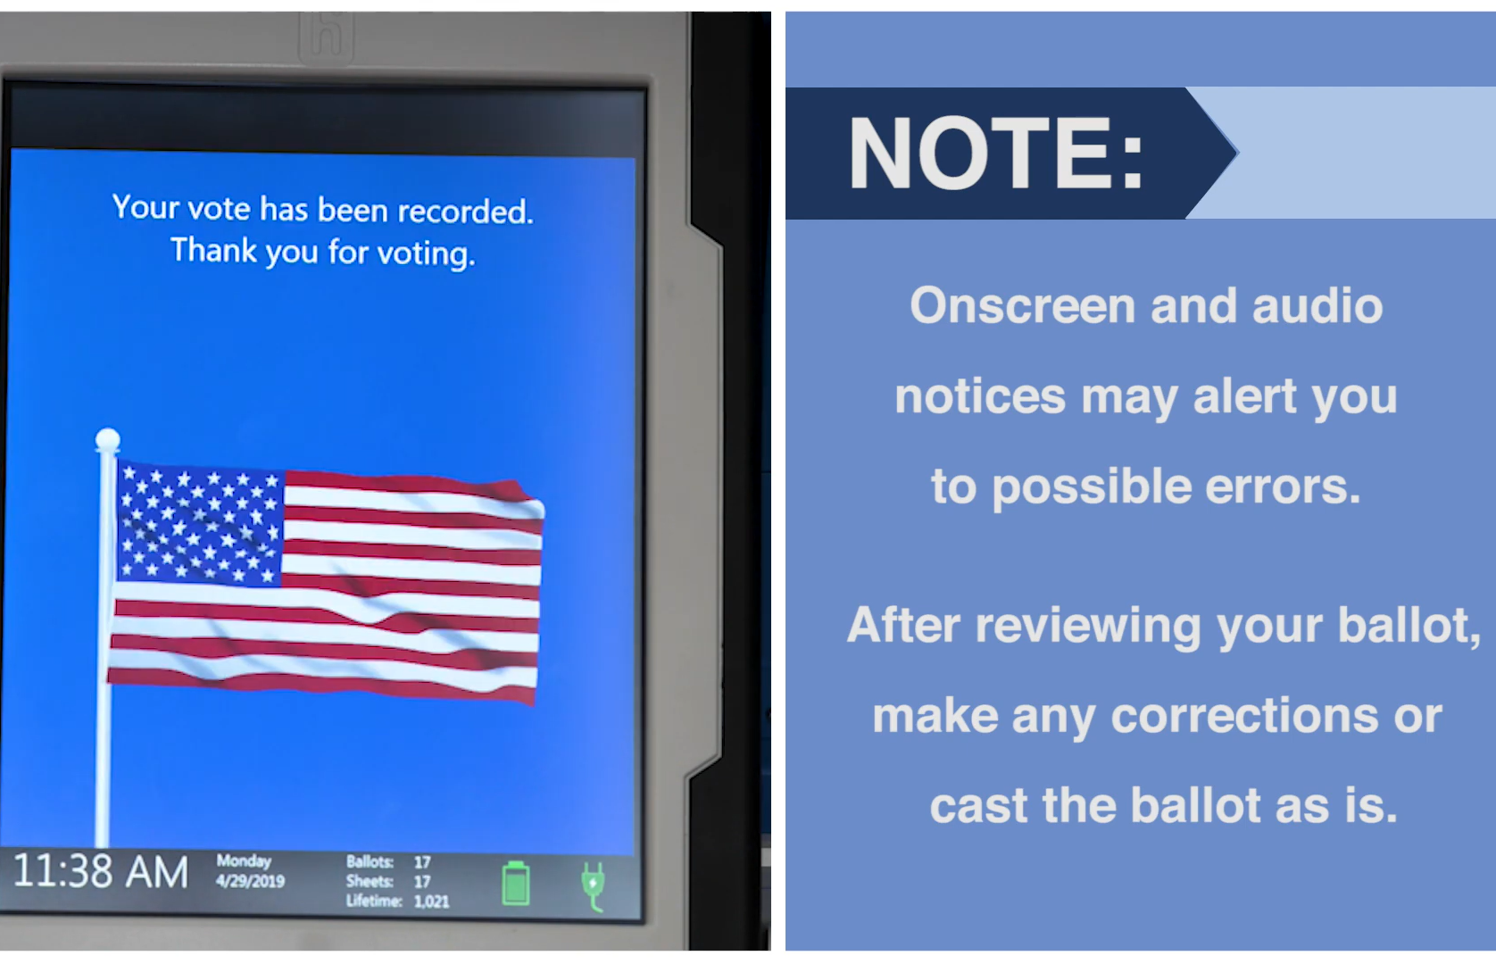
Casting the Ballot Training Video at: https://verifiedvoting.org/election-system/hart-intercivic-verity-scan/
The Verity Scan is ready to accept a ballot when the green arrows are lit and flashing.
Wait momentarily and the Ballot has been successfully processed when you see the waving American Flag.

Slide 43
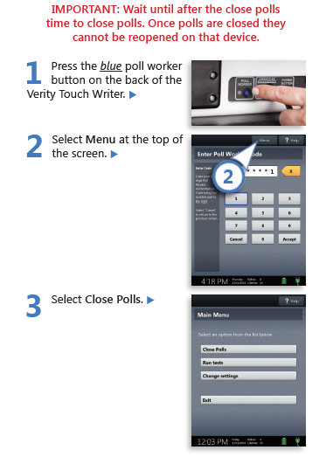

Closing Polls on TouchWriter

Slide 44


Closing Polls on Verity Scan

Slide 45

Data Runner
Election Judge will remove the VDrives from the Voting Machines and place in small, locking bag along with the closing print out tape.
Secure the bag with the numbered hasp.
Election Judge will deliver the data to the Elections Office as soon as possible.

Slide 46
Paperwork Completion
Each Election Judge and Alternate Judge will be responsible for completing and returning the required paperwork. Headings on every form should be completed even it there is nothing to report on the form. (Do this before the end of the day!)
It is highly recommended that each Election worker take the online Poll Worker Training available on the Secretary of State’s website at: https://pollworkertraining.sos.texas.gov/

Slide 47
Important Info On Closing
All Equipment should be dismantled and packed up in the exact fashion that it arrived.
All power cables and accessories should be stowed in the proper compartments.
Return all posted materials to the binder.
Stow all unused supplies in proper container for return.
The location should be left in the same condition that it was found at the beginning of the day.

Slide 48
Supplies Return
Each Election Judge is responsible for making sure that all supplies are returned to the Election Office on Election Night unless other arrangements have been made with the Election Office. (Can de delegated to another worker by the Judge.)
Supplies should be maintained orderly.
Checklist will be in the Precinct binder. Please use it.
All cables, extension cords, stylus and other supplies should be returned in the same fashion in which they were sent out.

Slide 49
Before you go today…
Please consider taking online course.
pollworkertraining.sos.texas.gov
Make sure you have signed the Roster sheet.
Please have the Office Telephone number handy: 903-575-0902 for Michelle or Kelly
Also have my cell phone number:
903-204-2790 Michelle

Slide 50




